Slide 1
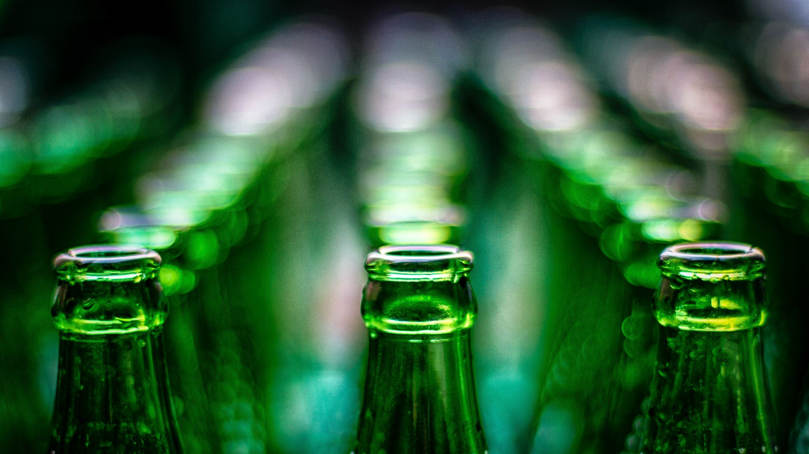
Logistic Regression of Beer Reviews
Big Data: Final Project
By Frank Rodriguez

Slide 2

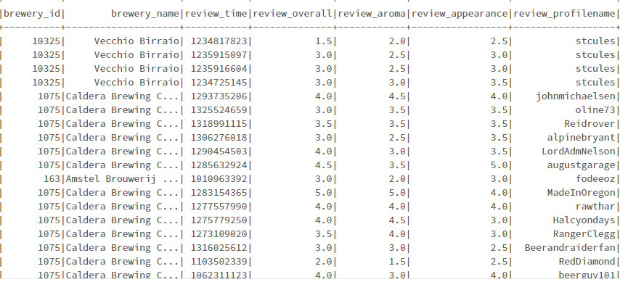
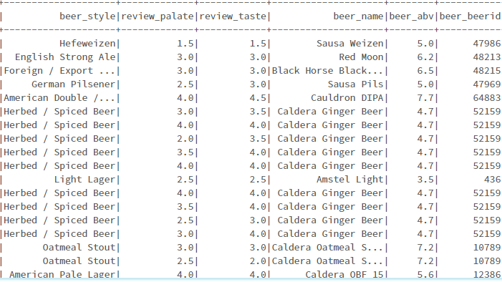
Our Dataset
Taken from Beer Advocate
Contained 1,586,614 rows and 13 columns
Features included:
Brewery
Beer Name & Style
Reviewer name
Beer ABV (alcohol by volume)
Review scores for:
Overall
Aroma
Appearance
Palate
Taste

Slide 3

Our Goal
The Overall Review scores were not continuous numbers, so we had to use Classification algorithms.
We aimed to create the most accurate model possible using the algorithms available in the pyspark.ml library.
We also looked to find what features were most highly correlated with our target variable (review_overall)

Slide 4
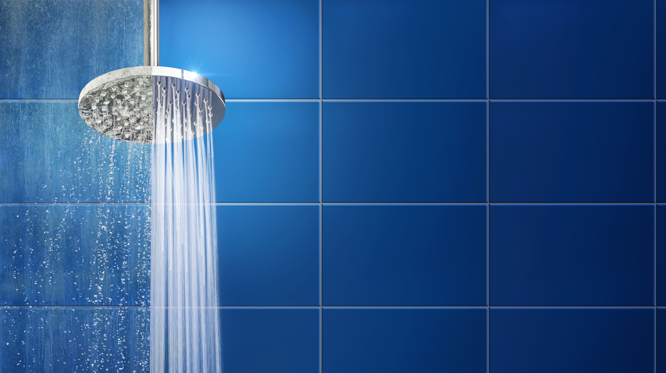
Data Cleaning & Feature Engineering
Removed nulls (68,148 mostly in ABV column)
Dropped id and review time columns
Checked for Duplicate rows (found none)
Performed feature engineering on 4 columns:
beer_style
review_profilename
brewery_name
beer_name

Slide 5
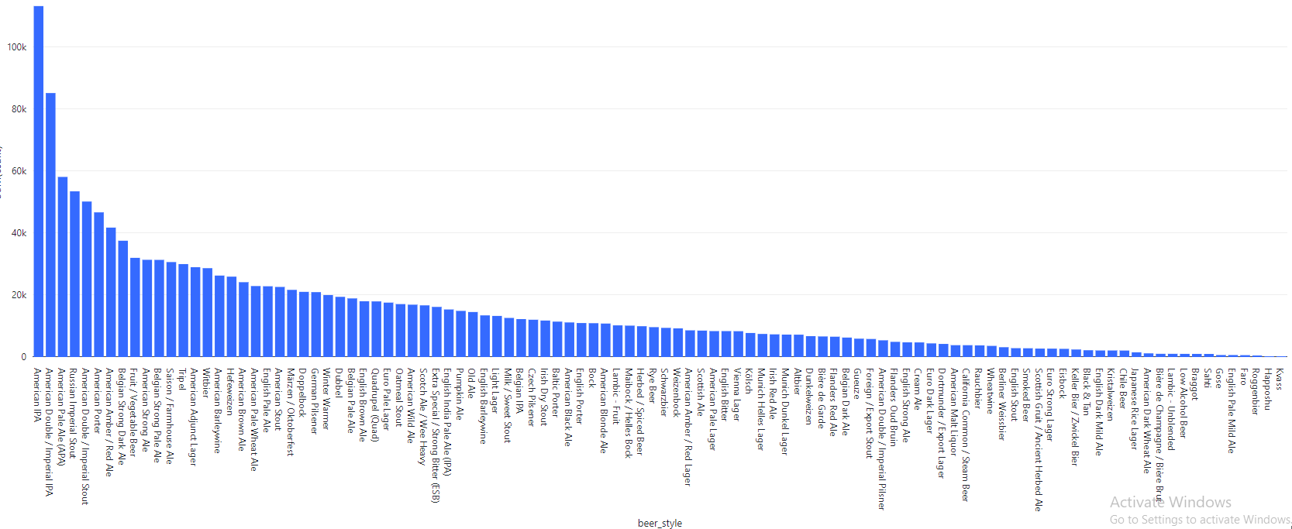
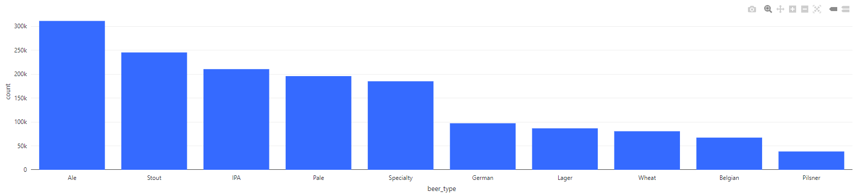
Beer Style
We took 104 different beer styles and engineered that down to 10 using our domain knowledge.

Slide 6
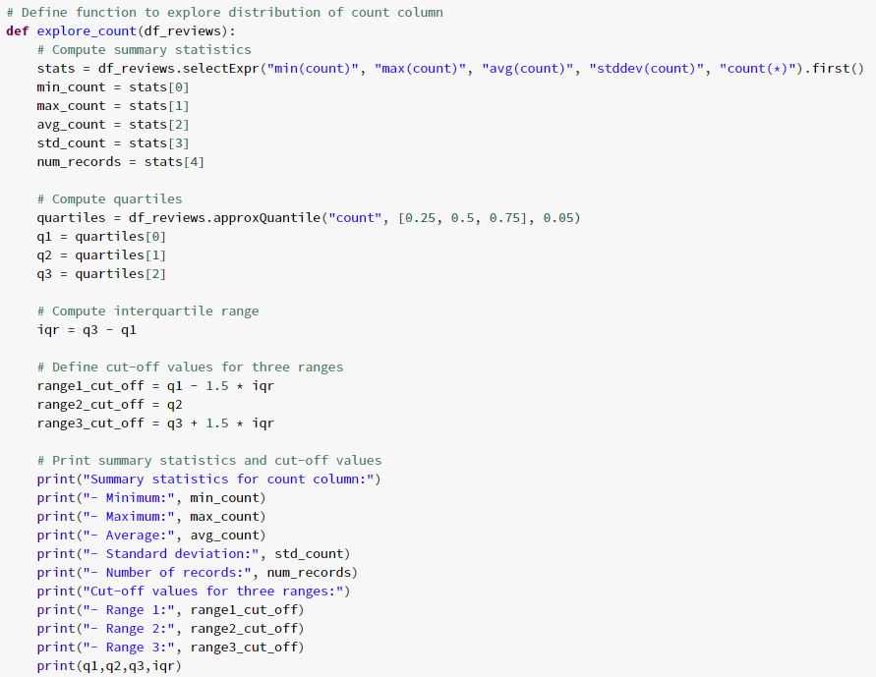
Review Profilename
The initial thought was to take and categorize each reviewer by the number of reviews they wrote.
But simply adding a new column called reviewer_total_reviews made much more sense.
Enjoy this beautiful code to the left that was never used.

Slide 7
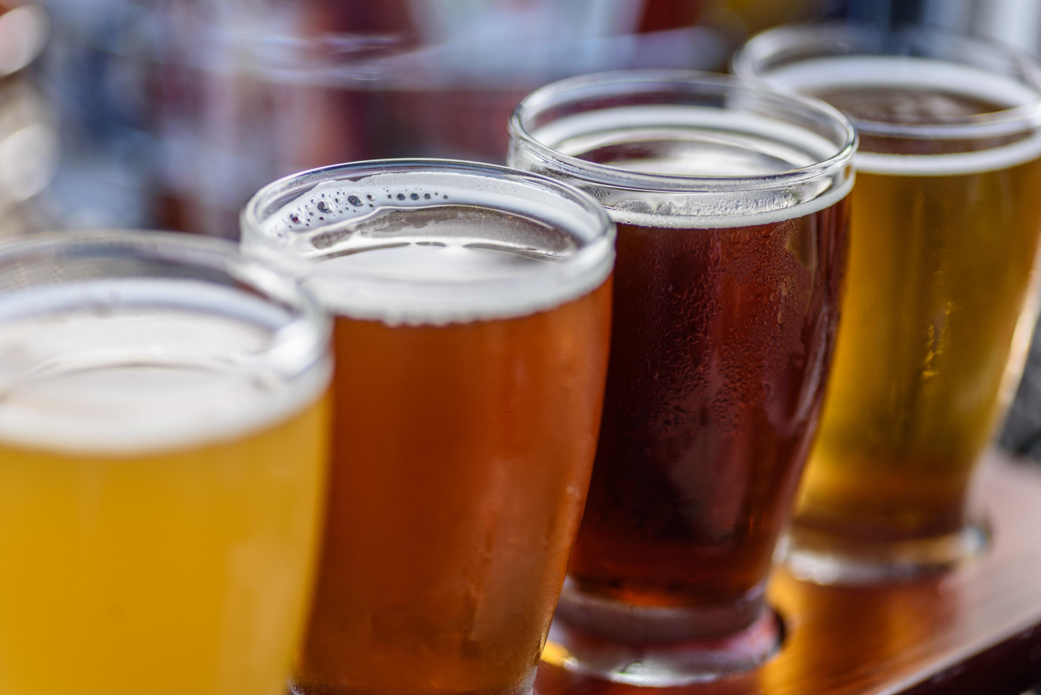
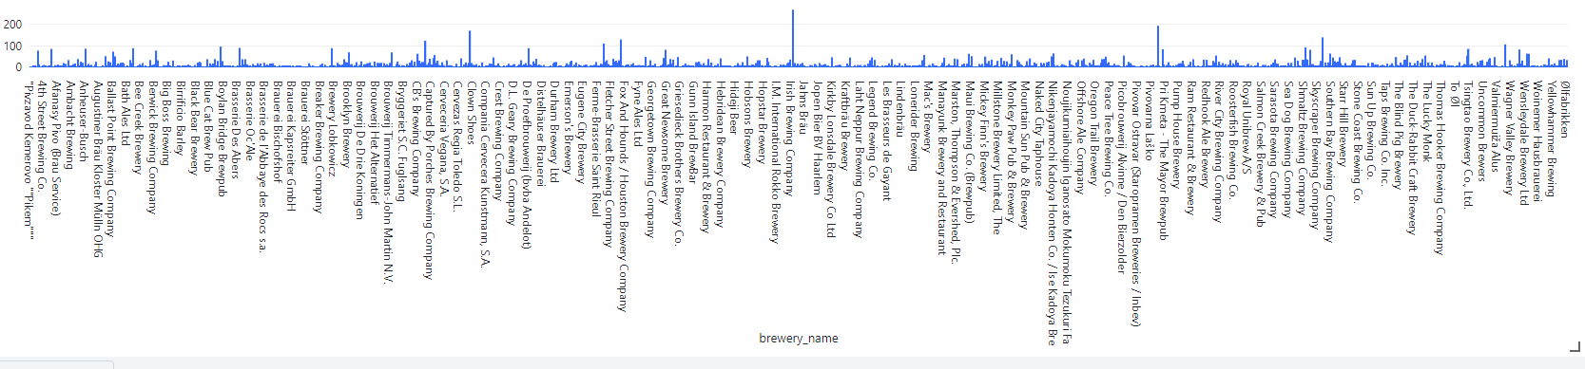
Brewery Name
We created a numeric column with a count of the number of beers each Brewery had in the dataset.

Slide 8
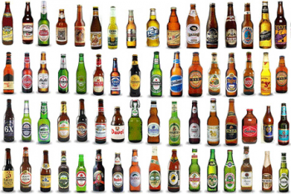
Beer Name
Our dataset contained 44,075 different beers
We created a new column that showed how many times each beer was reviewed
One beer alone had over 9,000 reviews (90 Minute IPA)

Slide 9
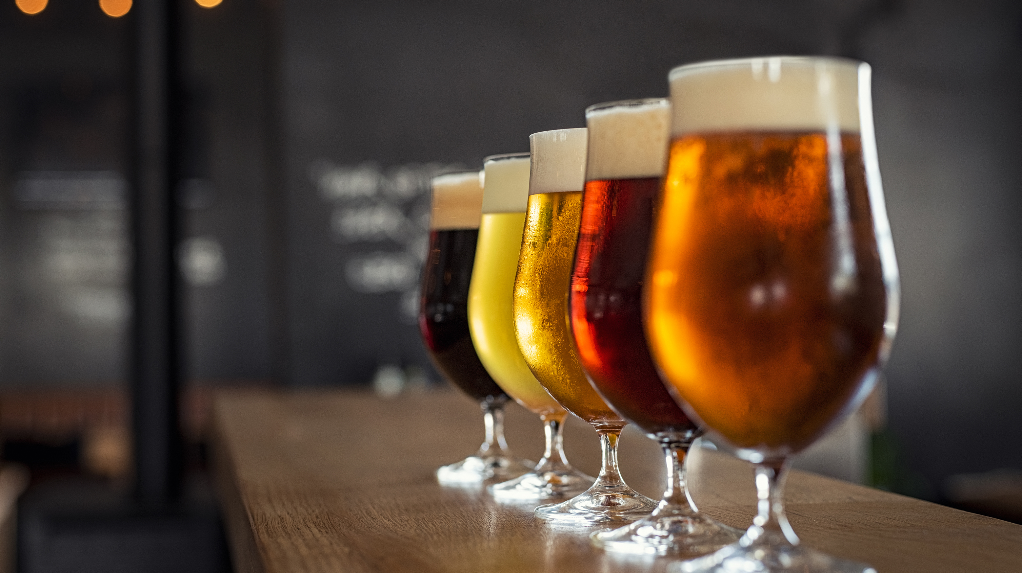
Correlations
Beer Alcohol By Volume: 0.1740
Review Appearance: 0.4513
Review Aroma: 0.5545
Review Palate: 0.6502
Review Taste: 0.7267
Reviewer Total Reviews: -0.0663
Total Beer Reviews: 0.1700
Total Brewery Beers: 0.1107

Slide 10

Logistic Regression
Train, test split of 80/20.
Beer style was one hot encoded.
MinMaxScaler was used.
The target variable of review_overall was indexed as review scores were ordinal.
An accuracy of 46.28% was obtained.
3 more algorithms were attempted:
Decision Tree – 50.94% accuracy
Random Forest – 49.18% accuracy
Naïve Bayes – 8.96% accuracy

Slide 11
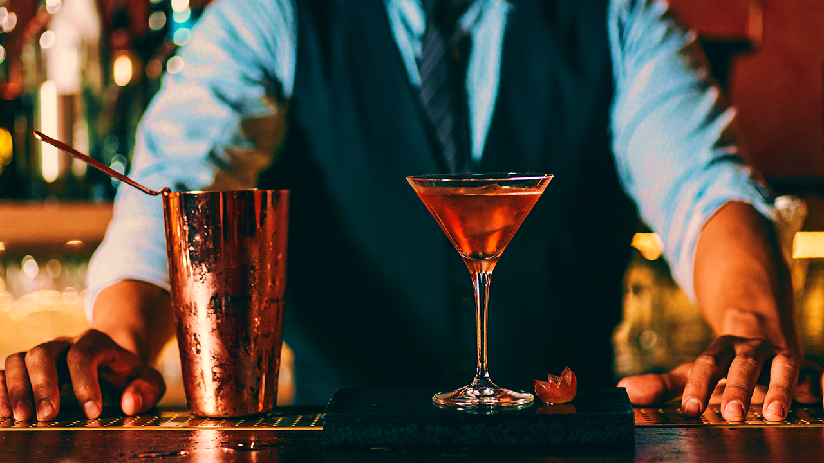
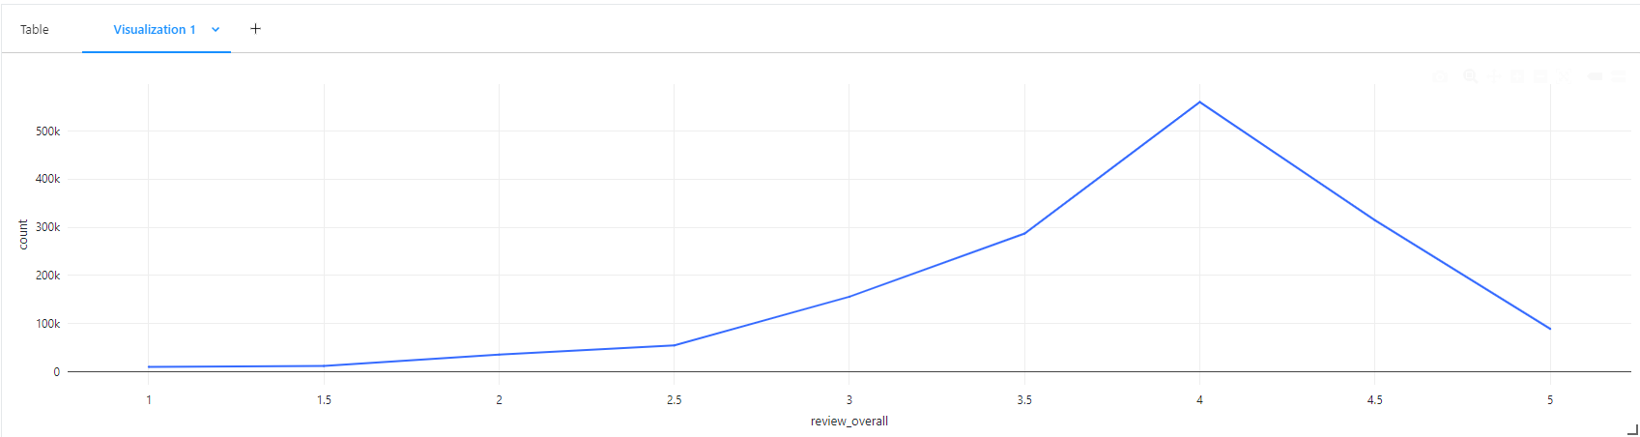
Future Work
Our target variable was heavily imbalanced with over half of the reviews receiving a 4 rating.
Under/Over sampling techniques would be employed to deal with this imbalance.
Actual review text can be added and analyzed via sentiment analysis.

Slide 12

References
https://www.beeradvocate.com/
https://www.kaggle.com/datasets/thedevastator/1-5-million-beer-reviews-from-beer-advocate
https://databricks-prod-cloudfront.cloud.databricks.com/public/4027ec902e239c93eaaa8714f173bcfc/6785621557910337/3079363186464447/6321104322114390/latest.html
https://databricks-prod-cloudfront.cloud.databricks.com/public/4027ec902e239c93eaaa8714f173bcfc/6785621557910337/2047455176859500/6321104322114390/latest.html

